Slide 1
PF1 Project

Slide 2
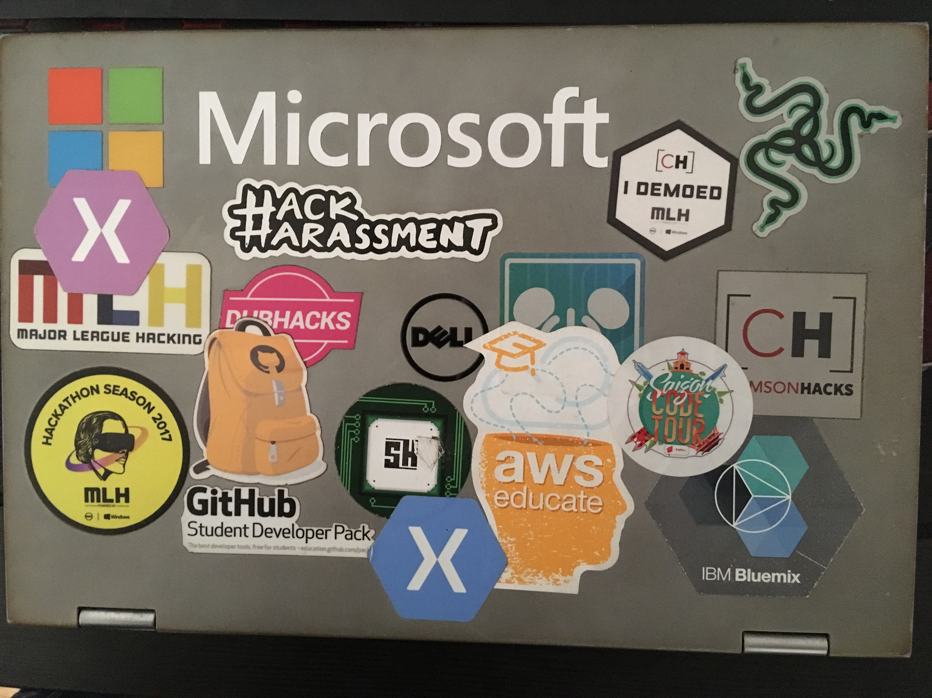

Slide 4

Flirt Detector
By Lê Lãm Thượng (Ted) and Mejrima Smajlbalsic

Slide 5
Data processing:
What you think
Notes:
For data processing, you would think that we would do hardcore coding to automatically classify the data. Nope, we did not do that

Slide 6
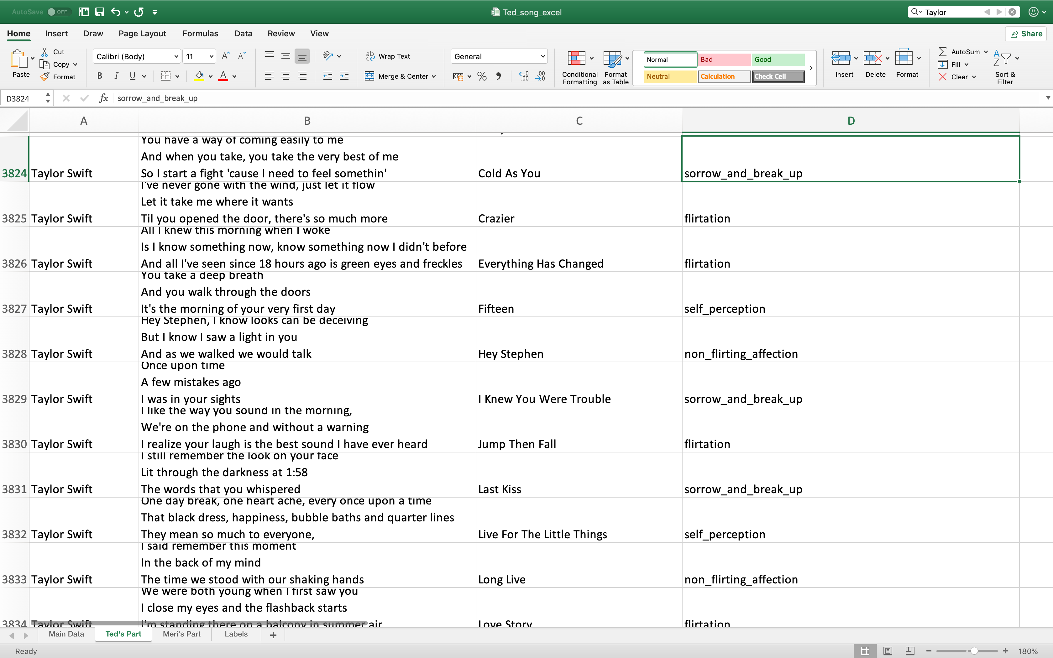
Notes:
Both Ted and I suffered through the most boring job on excel ever.

Slide 7
BUILD THE AI
We used TOP OF THE LINE TECHNOLOGY TO DO THIS

Slide 9
Notes:
We used Google AutoML Natural Language to accomplish this.

Slide 10
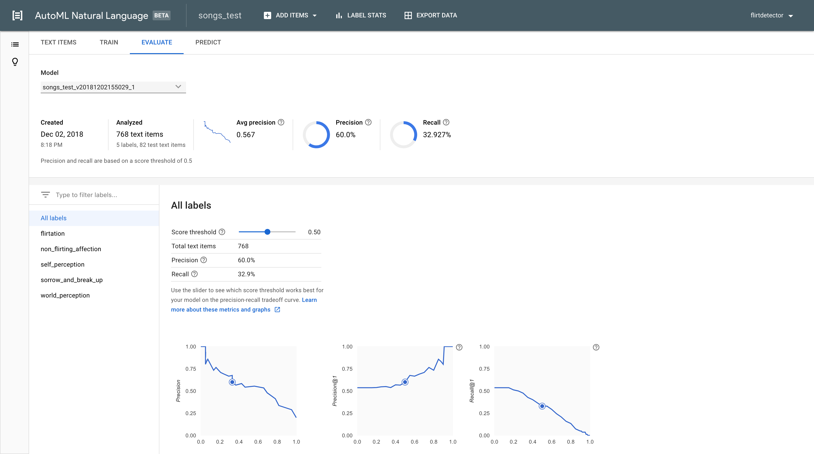

Slide 11
Open Authorization 2.0

Slide 12
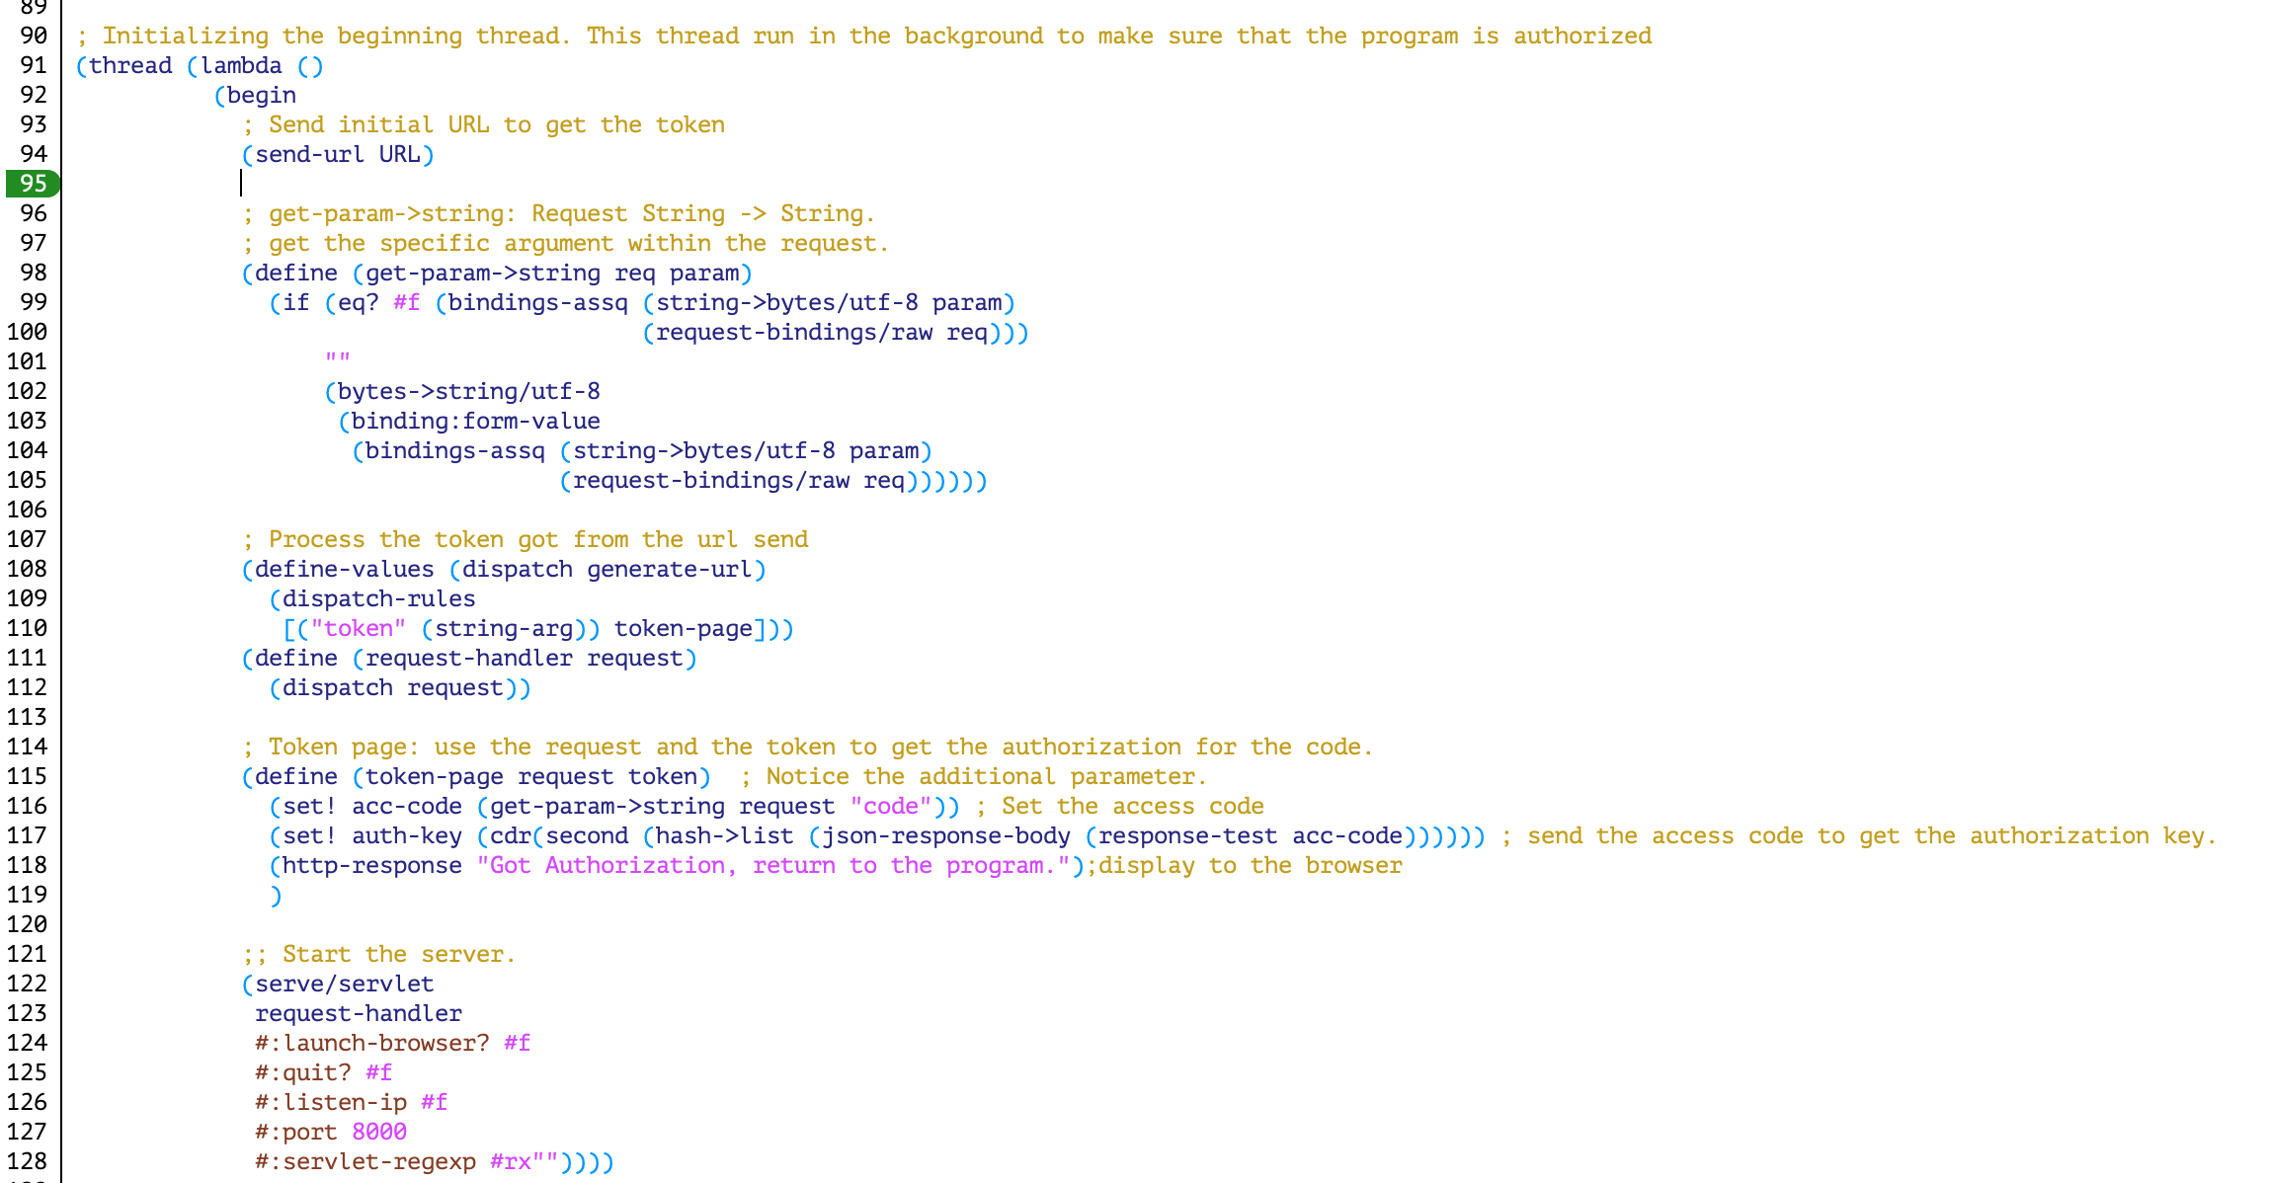

Slide 13
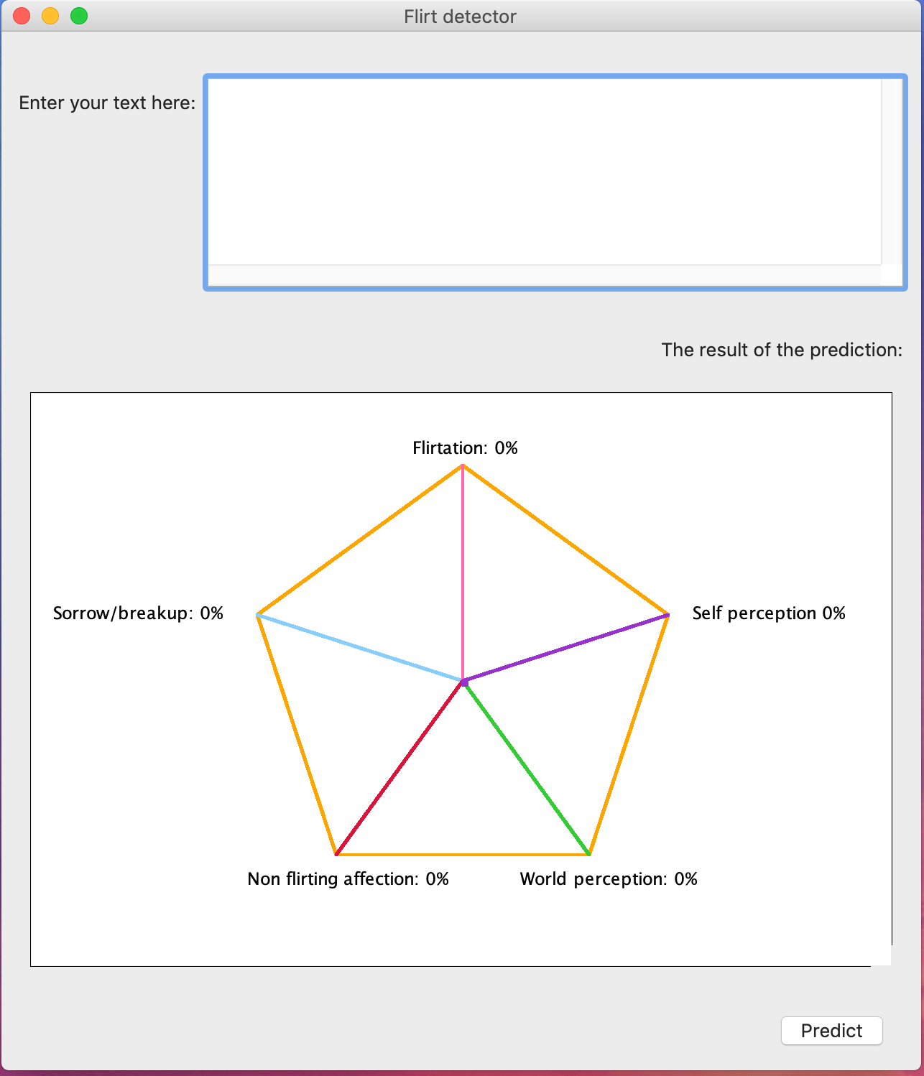
Notes:
After this, do sample

Slide 14
